Slide 1


Global Supply Chain Symposium in Mexico
May 21, 2019
St. Regis Hotel Mexico City https://www.mexicosymposium.uscsupplychain.com/
Partnership Opportunities Information Packet

Slide 2
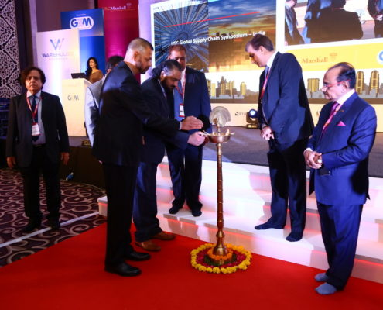
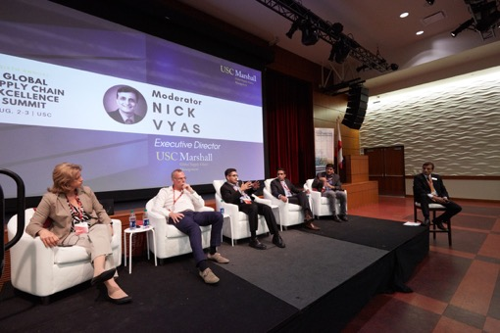
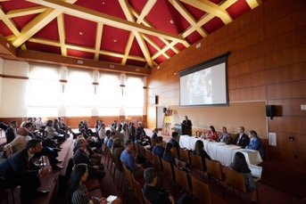
Symposium Overview
The USC Marshall Center for Global Supply Chain Management invites you to join the inaugural Global Supply Chain Symposium in Mexico on May 21, 2019.
This event is a unique opportunity for business executives and professionals to connect and share insights on how to strategically manage supply chains in a rapidly evolving local and global markets. Learn from a slate of business leaders and experts from the distinguished USC Marshall faculty will present on a series of thought provoking panels and keynote presentations.
Learn from and network with supply chain experts through:
Plenary Panels
Featured Speaker Presentations
Networking Luncheon and cocktail
Exhibit Space

Slide 3
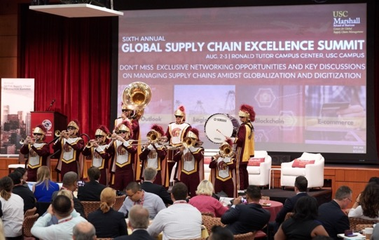
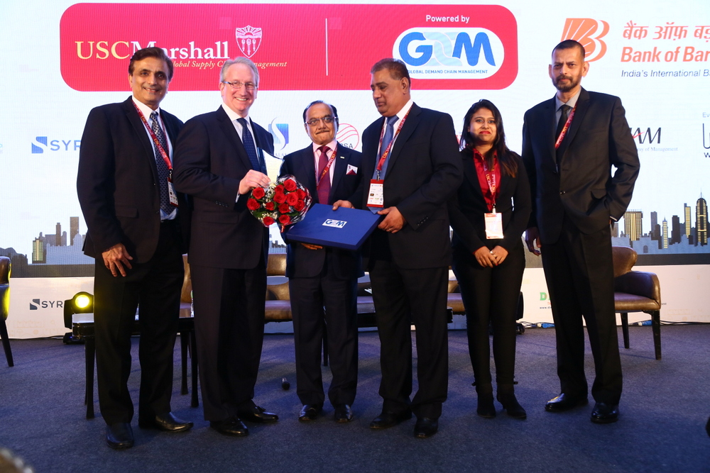
Discussion topics for the 2019 Mexico Symposium:
Blockchain
Disruptive Technologies
Modern Manufacturing
Sustainability
Risk Management
Retail & Unified Commerce
Logistics
Global Trade Outlook

Slide 4
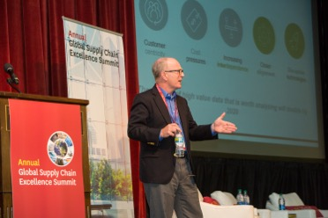
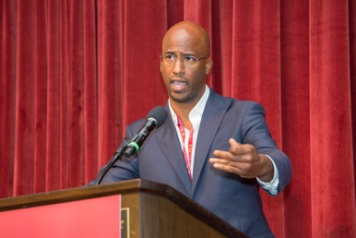
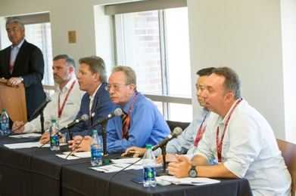
Our mission: To connect with leaders, develop a community, and create a transformation through
global supply chain excellence.
Sponsorship Benefits
Access unparalleled networking opportunities with top business leaders, officials, subject matter experts
Learn how to manage high-performing supply chains through insights from industry experience and applied research
Showcase your company as a sponsor to USC Marshall’s global network
Exclusive invitation and access to the Global Supply Chain Excellence Summit in Los Angeles August 8-9, 2019, and VIP reception
Proceeds will establish a Mexico scholarship in Global Supply Chain Management
Tax deductible in US

Slide 5
Benefits | Title ($15k) | Diamond ($10k) | Gold ($5k) | Cardinal ($2.5k)
One featured speaker position at Mexico Symposium (requires committee approval) or ticket value equivalent | 1
Panelist speaking positions at Summit (requires committee approval) or ticket value equivalent | 2 | 2
Opportunity to create a welcome video for the conference (during break or lunch) | X
Exhibit booth at the event | X | X
Complimentary tickets/Reserved Seating to the Mexico Symposium | 8 | 5 | 5 | 2
Prominent Display of logo on the Mexico Symposium website | X | X | X | X
Brochure, promotional items in giveaways | X | X | X | X
Access to the Exclusive VIP Reception at the Los Angeles Summit | 6 | 4 | 2
Tickets to Los Angeles Global Supply Chain Excellence Summit | 6 | 4 | 2

Slide 6
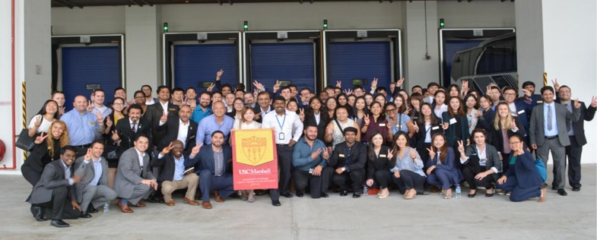
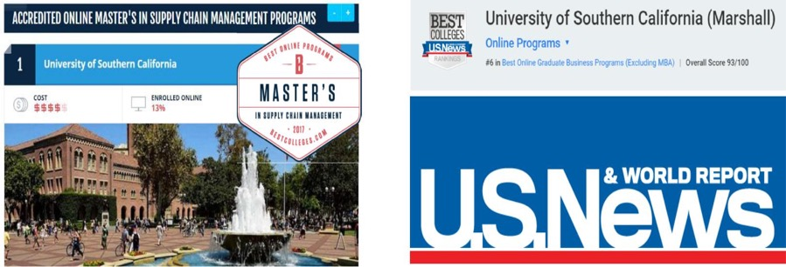
Overview of the Center
Mission: “Connecting the world through Global Supply Chain Excellence with Network, Education, and Applied Research (NEAR)”
The Master of Science in Global Supply Chain Management is a joint program offered by the Marshall School of Business in collaboration with the Viterbi School of Engineering, two top ranked professional schools at the University of Southern California.
The program is top-ranked on U.S. News & World Report, and Bestcolleges.com.

Slide 7
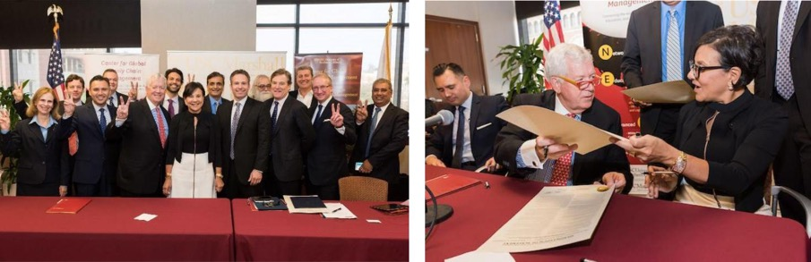
Partnership with U.S. Department of Commerce
In October 2016, USC joined forces with the United States Department of Commerce.
USC hosted a joint signing ceremony between the USC Marshall Center for Global Supply Chain Management with the U.S. Department of Commerce. Notable attendees at the ceremony included Dean of the USC Marshall School of Business, James Ellis, Mayor of Los Angeles, Eric Garcetti, and then-Secretary of Commerce, Penny Pritzker.
The partnership with USC Marshall allows for collaboration on digitalization of the nation’s supply chains, including applications to IoT (Internet of Things).

Slide 8

A Global Perspective
The Center for Global Supply Chain Management expands its reach globally through strategic partnerships and initiatives.
These include:
MOU signing with the Pontificia Universidad Catolica Madre y Maestra Dominican Republic
Partnership with Port of Los Angeles and Port Antwerp
New humanitarian initiative to sponsor 2 students from the African continent to bring on to the GSCM program
Global roundtables held in Brazil, Peru, India, Japan and Mexico (board members are invited to attend)

Slide 9
Contact Us
To discuss the partnership opportunity in-depth, please reach out to:
Larry Malanga: larry.malanga@mexflex.com
Angela McCracken : angela@usc.edu
Nick Vyas: nikhilvy@marshall.usc.edu
https://www.mexicosymposium.uscsupplychain.com/
https://uscsupplychain.com/
We hope to collaborate with you soon. Thank you!

