Slide 1


Current Status & Business Outlook
Mexico`s Industrial Market
Rafael Arias
Mexico Central Region VP Market Officer
Prologis

Slide 2
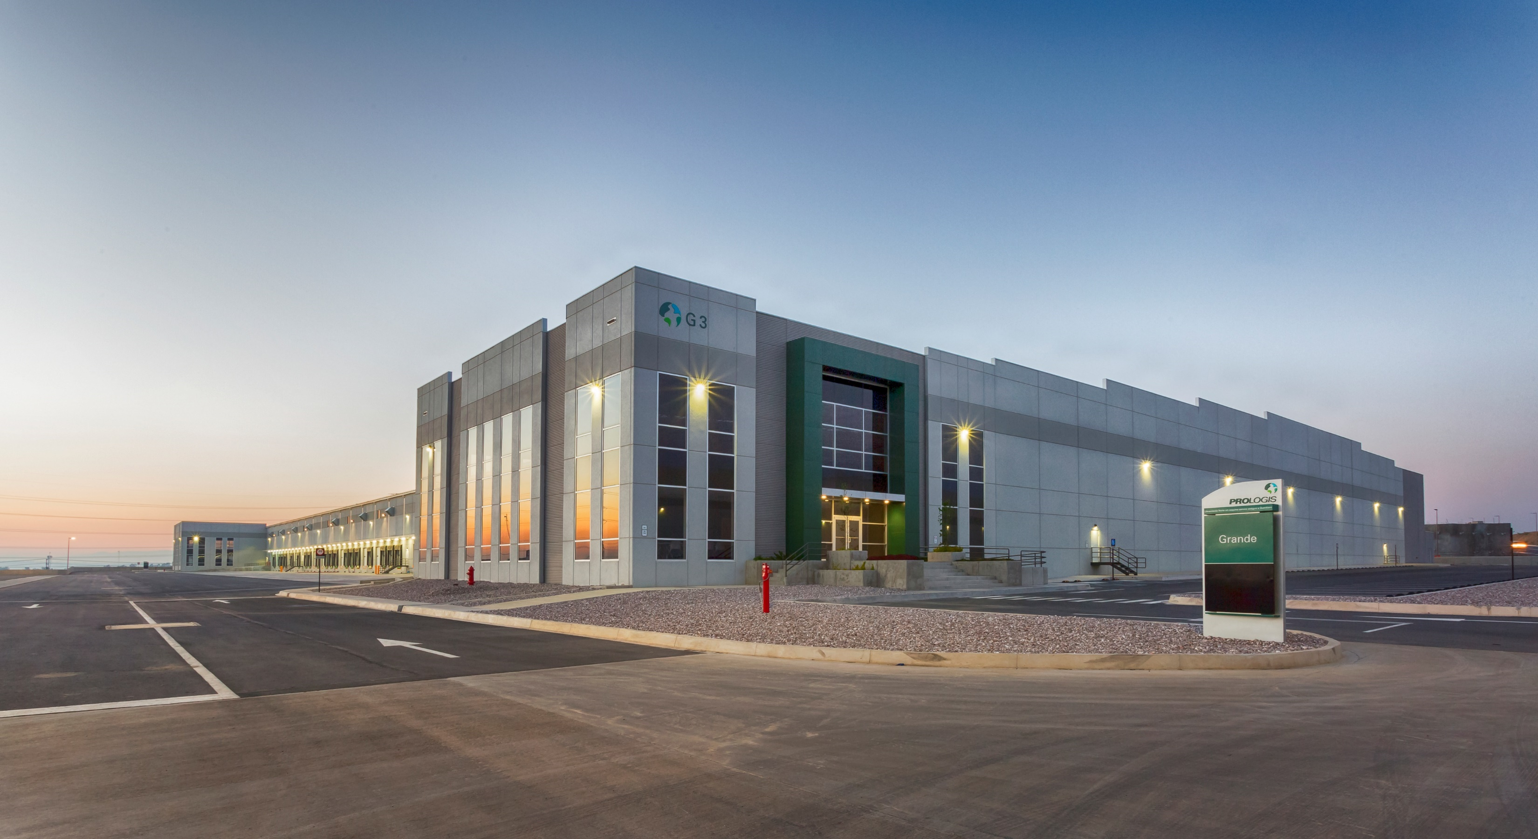
Prologis Park Grande, Mexico City, Mexico
USC Global Supply Chain Symposium
Rafael Arias, Prologis Mexico Central Mexico VP MKT Officer
May 21th 2019

Slide 3
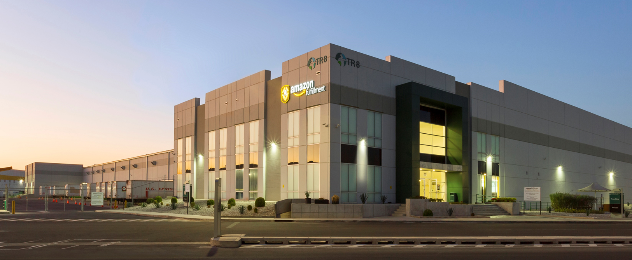
MXC Industrial MKT Fundamentals
Tres Rios #8, Mexico City

Slide 4
Real Estate Fundamentals
Demand (TTM) vs Supply (Pipeline)
(MSF)
Demand vs Supply
(MSF)
Vacancy
(%)
Balanced supply and demand in 2017 and 2018 with historical low market vacancies
Political uncertainty impacting development cycle more so than customer demand
Mexico City’s market vacancy for Class-A product below 2.0%
Scarcity of available modern product is driving customers to sign pre-leases on speculative supply currently under construction in Mexico City
Sources: CBRE, NAI, Prologis Research
Sources: CBRE, Prologis Research
Data as of March 31, 2019
BTS is defined as build to suit
TTM is defined as trailing twelve months

Slide 5
Structural Drivers Build Logistics Real Estate Demand
Robust Retail Sales Growth
Index, 2008 = 100, 2008 Pesos
Young & Growing Population
Working Age Population, Millions of People
Rising Consumer Class
Personal Disposable Income, Index, 2008 = 100, 2008 Pesos
Growth in Higher Wage Sectors
%, Ag. Jobs as a % of Total %, Services Jobs as a % of Total
Source: Oxford Economics, Prologis Research

Slide 6
Mexico Economy Strongly Linked to U.S. Performance
Mexico-U.S. Economies Intertwined
%, Real GDP Growth
  Mexican economy buoyed by U.S. throughout the cycle
  North American value chains are deeply intertwined, with parts often crossing the border multiple times prior to product completion
  Share of U.S. value added in Mexican exports is high and more than 1/3 of gross exports
Sources: IMF, Consensus Economics (forecast), Prologis Research

Slide 7
E-Commerce Becoming an Added Demand Driver
Significant E-Commerce Sales, Mexico
Billions, MXN, Constant 2017 Prices
Positive Upside in Internet Penetration
%, Internet Sales as a Share of Total Retail Sales
E-commerce becoming an added tailwind for logistics real estate demand, especially in Mexico City
Mexican e-commerce sales grew 25% year-over-year in 2017
E-commerce penetration in Mexico still in nascent development stage relative to global market peers
Intensive users of logistics space; ~3X traditional brick & mortar
Mexico
Source: Euromonitor, Prologis Research
Note: Excludes sales tax and travel spending; E-commerce sales exclude consumer-to-consumer transactions

Slide 8
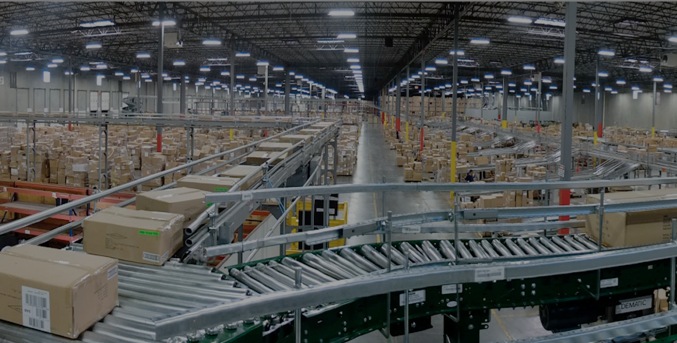
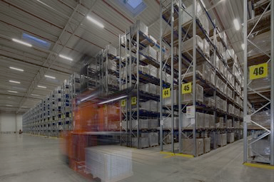
E-Commerce Requires ~3X the Distribution Space of Traditional Retail
Sales US$, B | Facilities SF, M | Productivity US$ / SF | Efficiency SF / $1B
$228B | 286 | $799 | 1,251 KSF
E-fulfillment requires 3X the logistics space used of brick-and-mortar retailers due to:
Shipping parcels versus pallets
High inventory level
Broader product variety (ie increased SKUs)
Reverse logistics
Online
+
/
+
3x
-
$1,068B | 510 | $2,091 | 478 KSF
Brick & Mortar
Source: Internet Retailer, company filings, Prologis Research

Slide 9
MXC City Rent Growth 2013 - 2018
Avg. Lease Rents Signed in Mexico City
MXN Rents/SF/Year
⁽¹⁾
⁽²⁾
Data as of March 31, 2019
MXN net effective rent per square foot per year for prime assets which are defined as a Class-A building with best-in-class design in the best submarket. An example of prime assets are those located at Prologis Park Tres Rios
Net effective rents signed in Mexico City in Mexican pesos and U.S dollars for prime assets

Slide 10
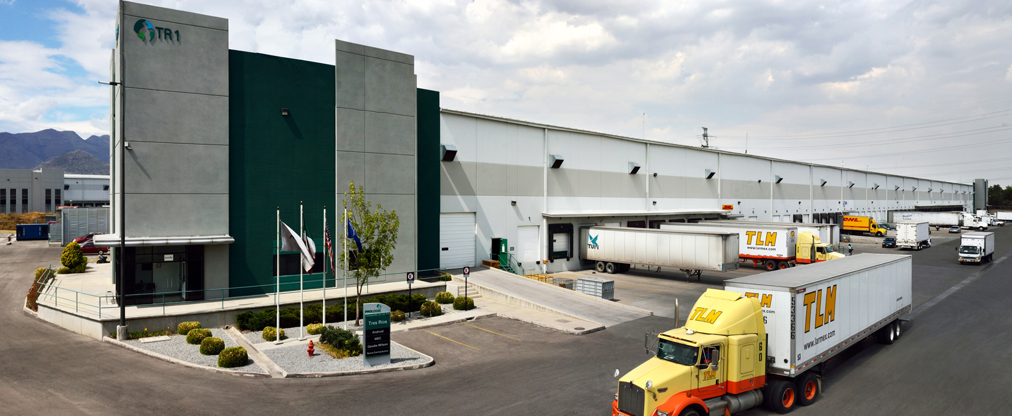
MXC Industrial MKT Status
Tres Rios #1, Mexico City

Slide 11
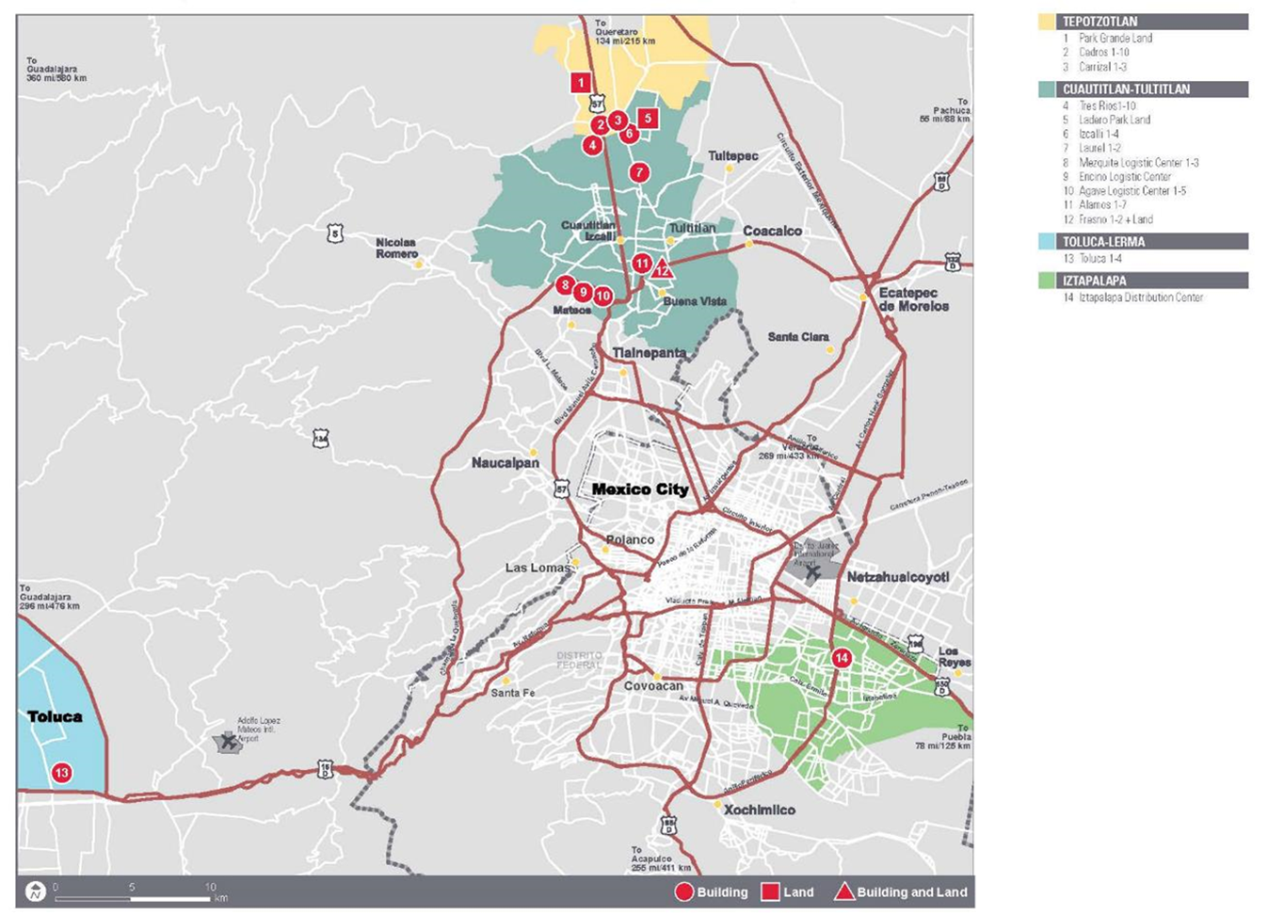
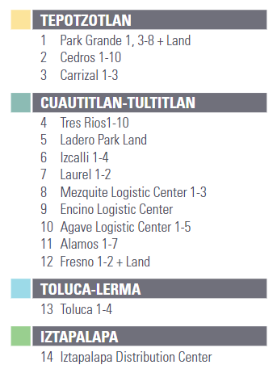
Mexico Market Map

Slide 12
Mexico City Market Snapshot
Overall Market | Industrial Base MSF | Current Occupancy * | Occupancy % Prior |  |  | Net Absorption MSF Prior |  |  | Construction Starts MSF Prior
 |  |  | 12/31/16 | 12/31/17 | 12/31/18 | 12/31/16 | 12/31/17 | 12/31/18 | 12/31/16 | 12/31/17 | 12/31/18
Mexico City (Overall Market) | 95.8MSF | 96.6% | 97.1% | 97.8% | 99.0% | 10.6 | 8.0 | 5.7 | 3.7 | 4.6 | 7.0
CTT | 63.8MSF | 96.0% | 97.7% | 96.9% | 98.0% | 7.0 | 5.1 | 3.8 | 3.0 | 4.2 | 5.2
Prologis Portfolio | 14.6 MSF | 98.5% | 98.3% | 97.0% | 98.9% | 2.0 | 1.5 | 1.3 | 0.3 | 2.1 | 1.4
*Prologis Portfolio Current Occupancy as of 03/31/19.

Slide 13
Operating Portfolio & Development Leasing 2018
Mexico City
MXC Net Absorption – 5.7M SF
MXC Dev Starts & Completions – 7M SF / 5.9M SF
Operating Portfolio 2018:
  27 transactions totaling 2.5M SF.
  Retention – 75.6%
  Rent Change – 13.1%
  WALT 51.4 Mos.
  Key Bets: Grande6 (117K SF) & Cedros3 (223K SF).
MXC Portfolio has a vacancy of 1.5%, so we are focusing in increasing rent change and WALT in renewals and new deals, situation that explains our drop in Retention.

Slide 14
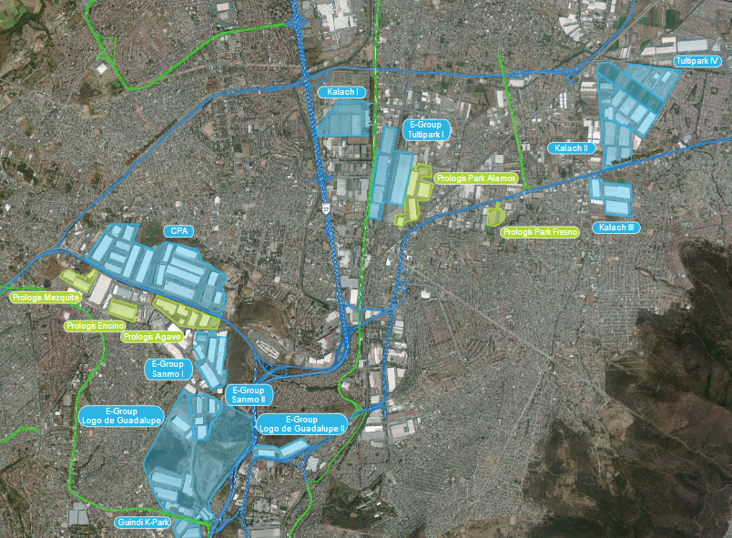
CTT SOUTH Submarket Aerial

Slide 15
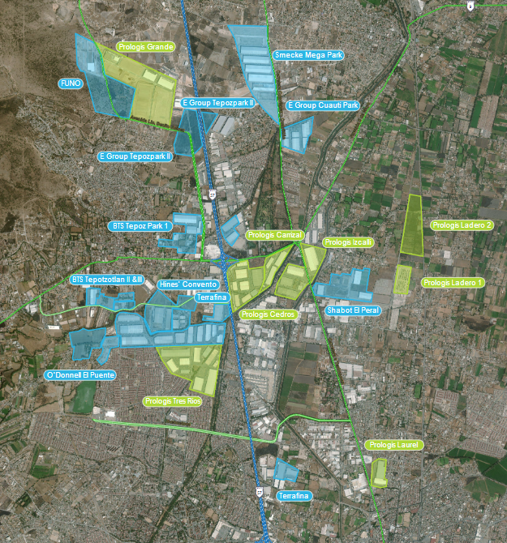
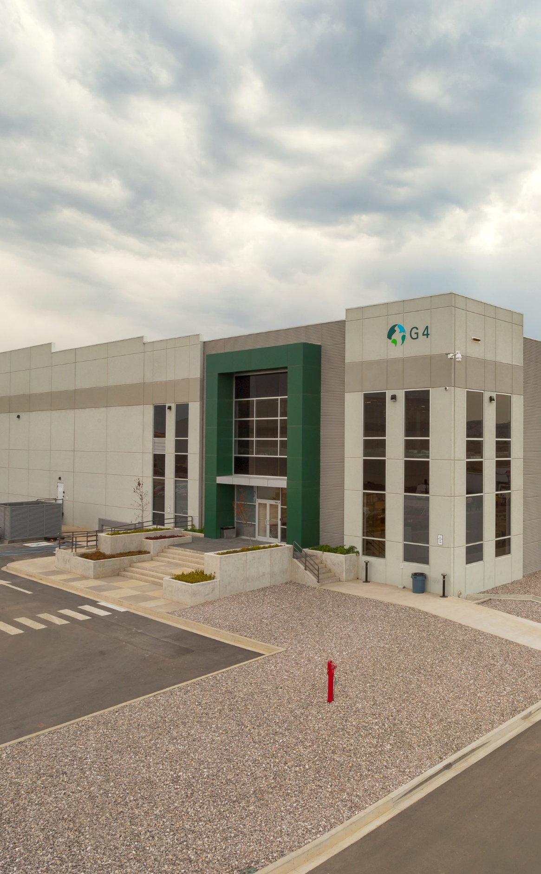
CTT NORTH Submarket Aerial

Slide 16
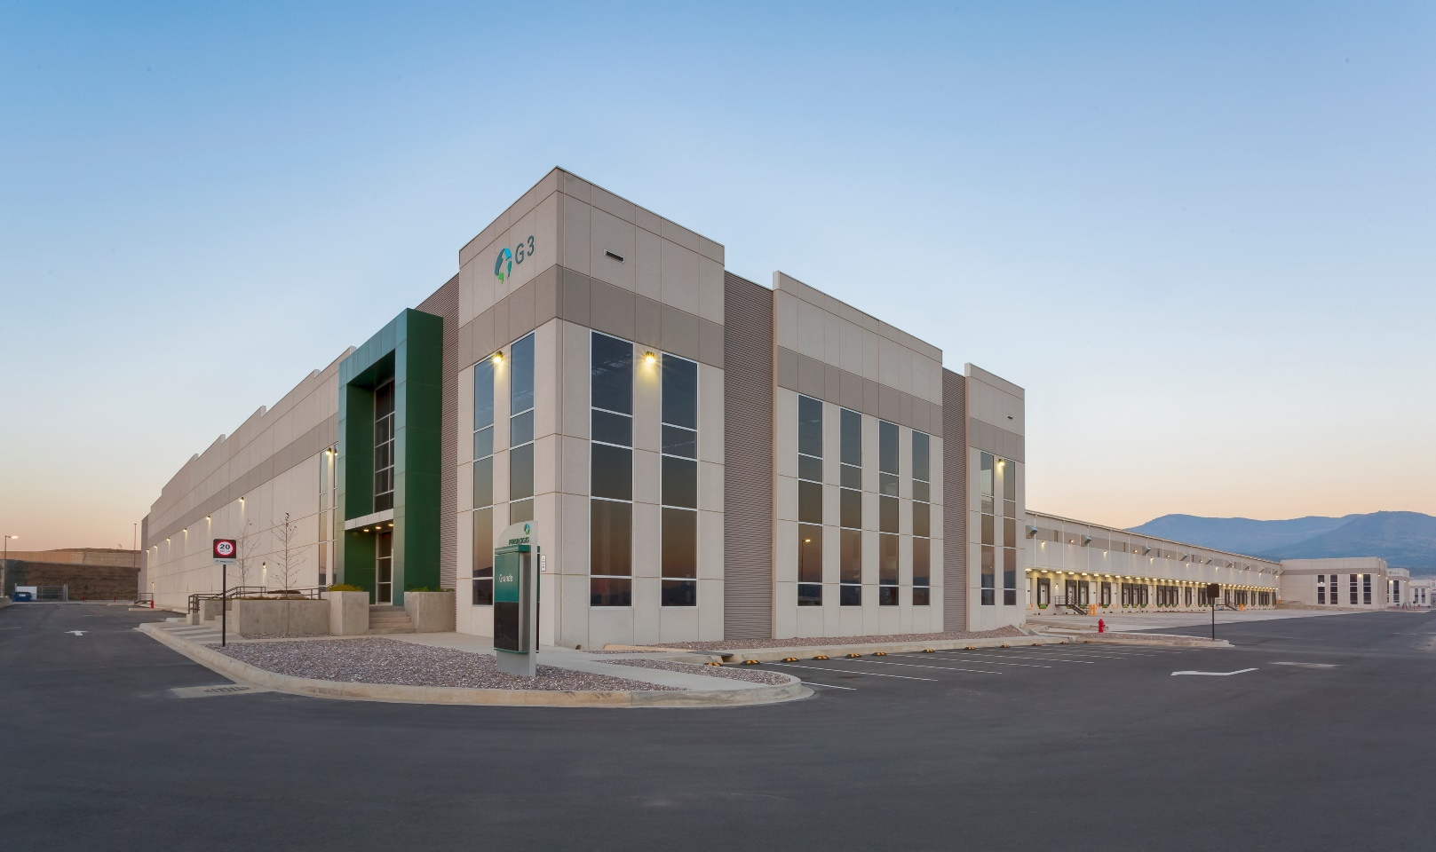
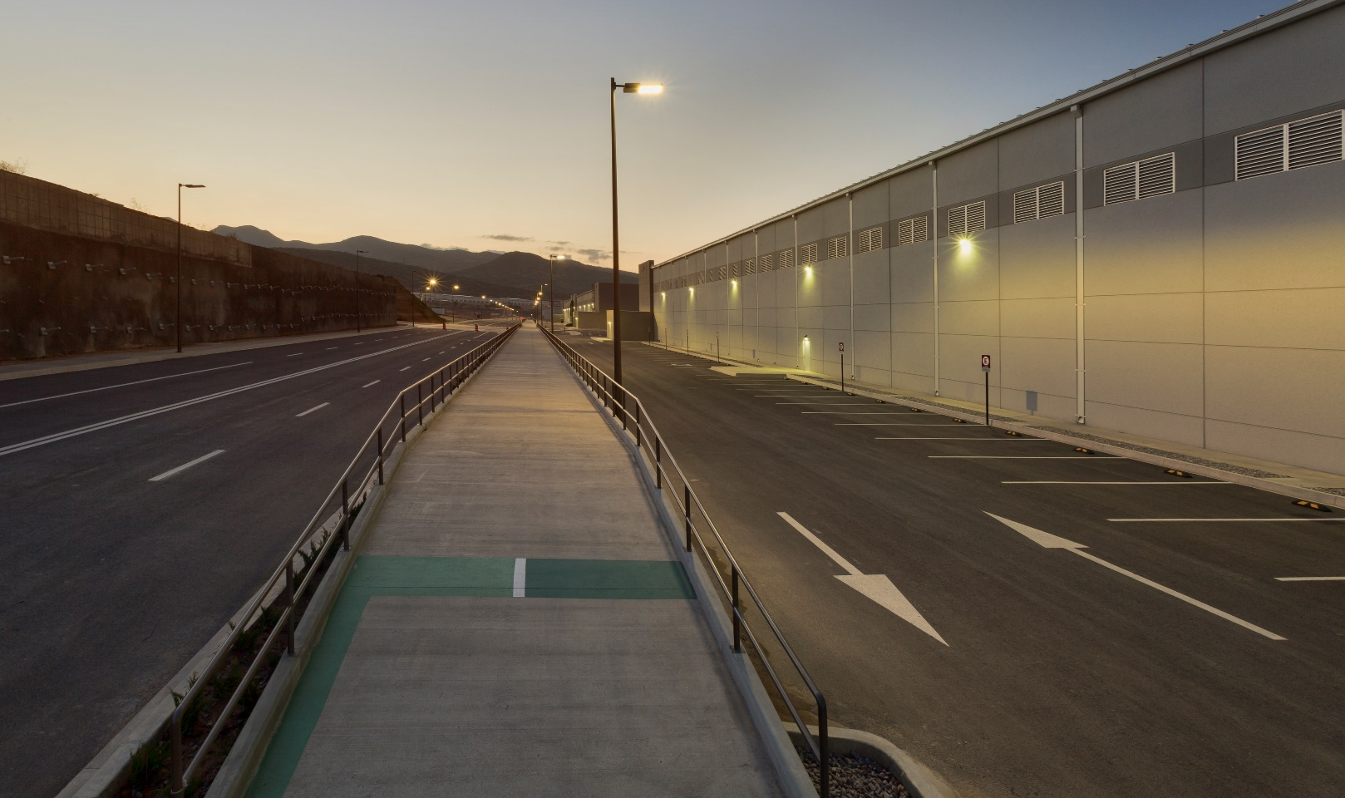
Prologis Park Grande
Specifications
Buildings with LEED Gold certificate.
Equipped Dock Doors: 1 per 1,000 SM.
Office Area: 3% of the total leased area.
Property Management Team in Site.
Canalization for telephone & data.
Controlled and secure entry.
Close Proximity to Mexico-Queretaro Highway Circuito Exterior Mexiquense and Arco Norte bypass.

Slide 17
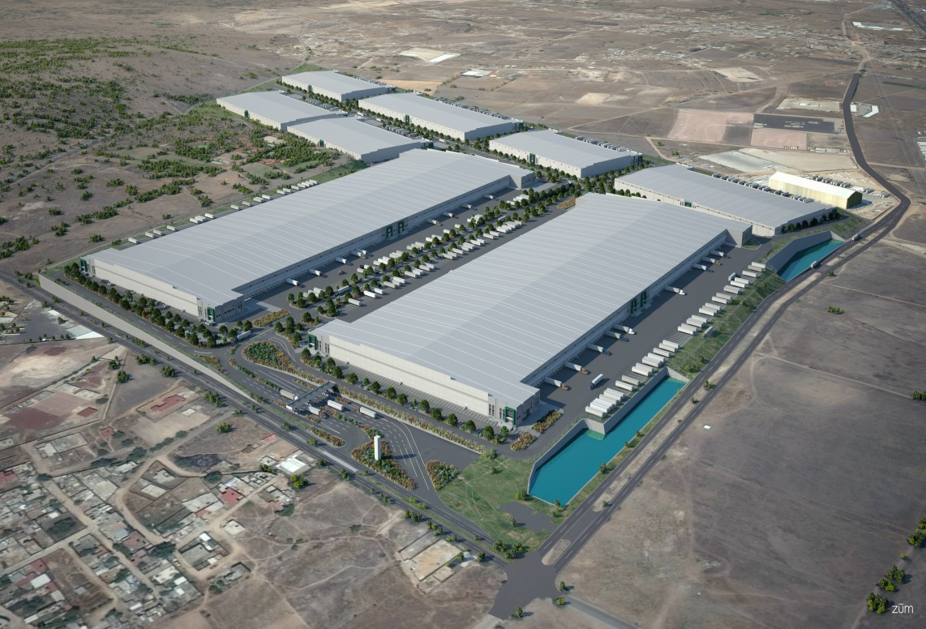
Potential Future Investments
B-6
Prologis Park Grande
Location: Mexico City
Land Size: 212.3 acres, 9.3 MSF
Potential Build Out: 3.9 MSF
Fully leased: Buildings 1, 2, 3, 4, 5, 7 and 8 (3.6 MSF)
Built: Buildings 1, 3, 4, 5, 6, 7 and 8 (2.93 MSF)
Built and partially leased: Building 6 (0.3 MSF)
Under construction: Building 2 (1.0 MSF).
Unique Competitive Advantage:
  State of the art logistics park focused on e-commerce customers and consolidation of 3PL customers
  Strategically located in the land constrained premier Class-A building corridor of Mexico City
B-7
B-5
B-8
B-4
1.0 MSF
B-3
B-2
1.0 MSF
B-1
Current Land Site
Note: The properties at Prologis Park Grande are owned by Prologis and no assurances can be given that FIBRA Prologis will acquire these properties

Slide 18
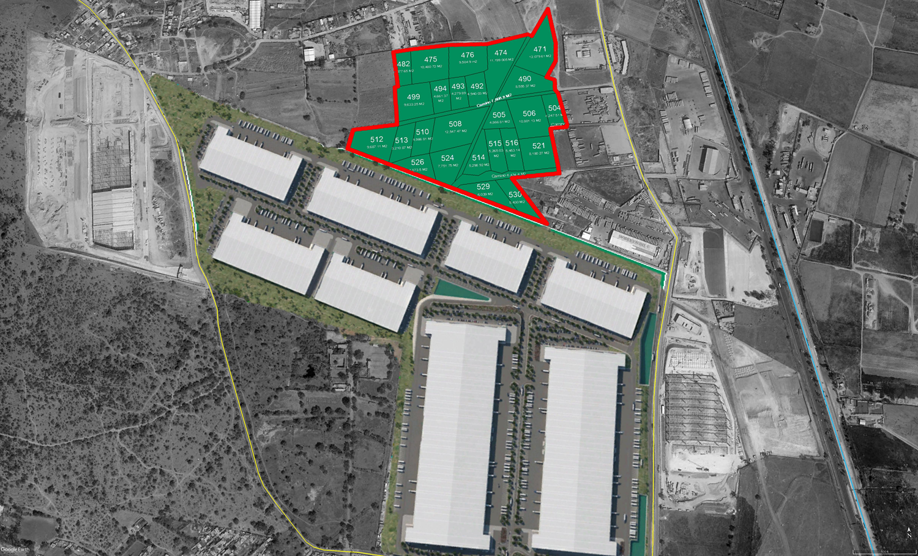
Space plan
Prologis Park Grande North

Slide 19
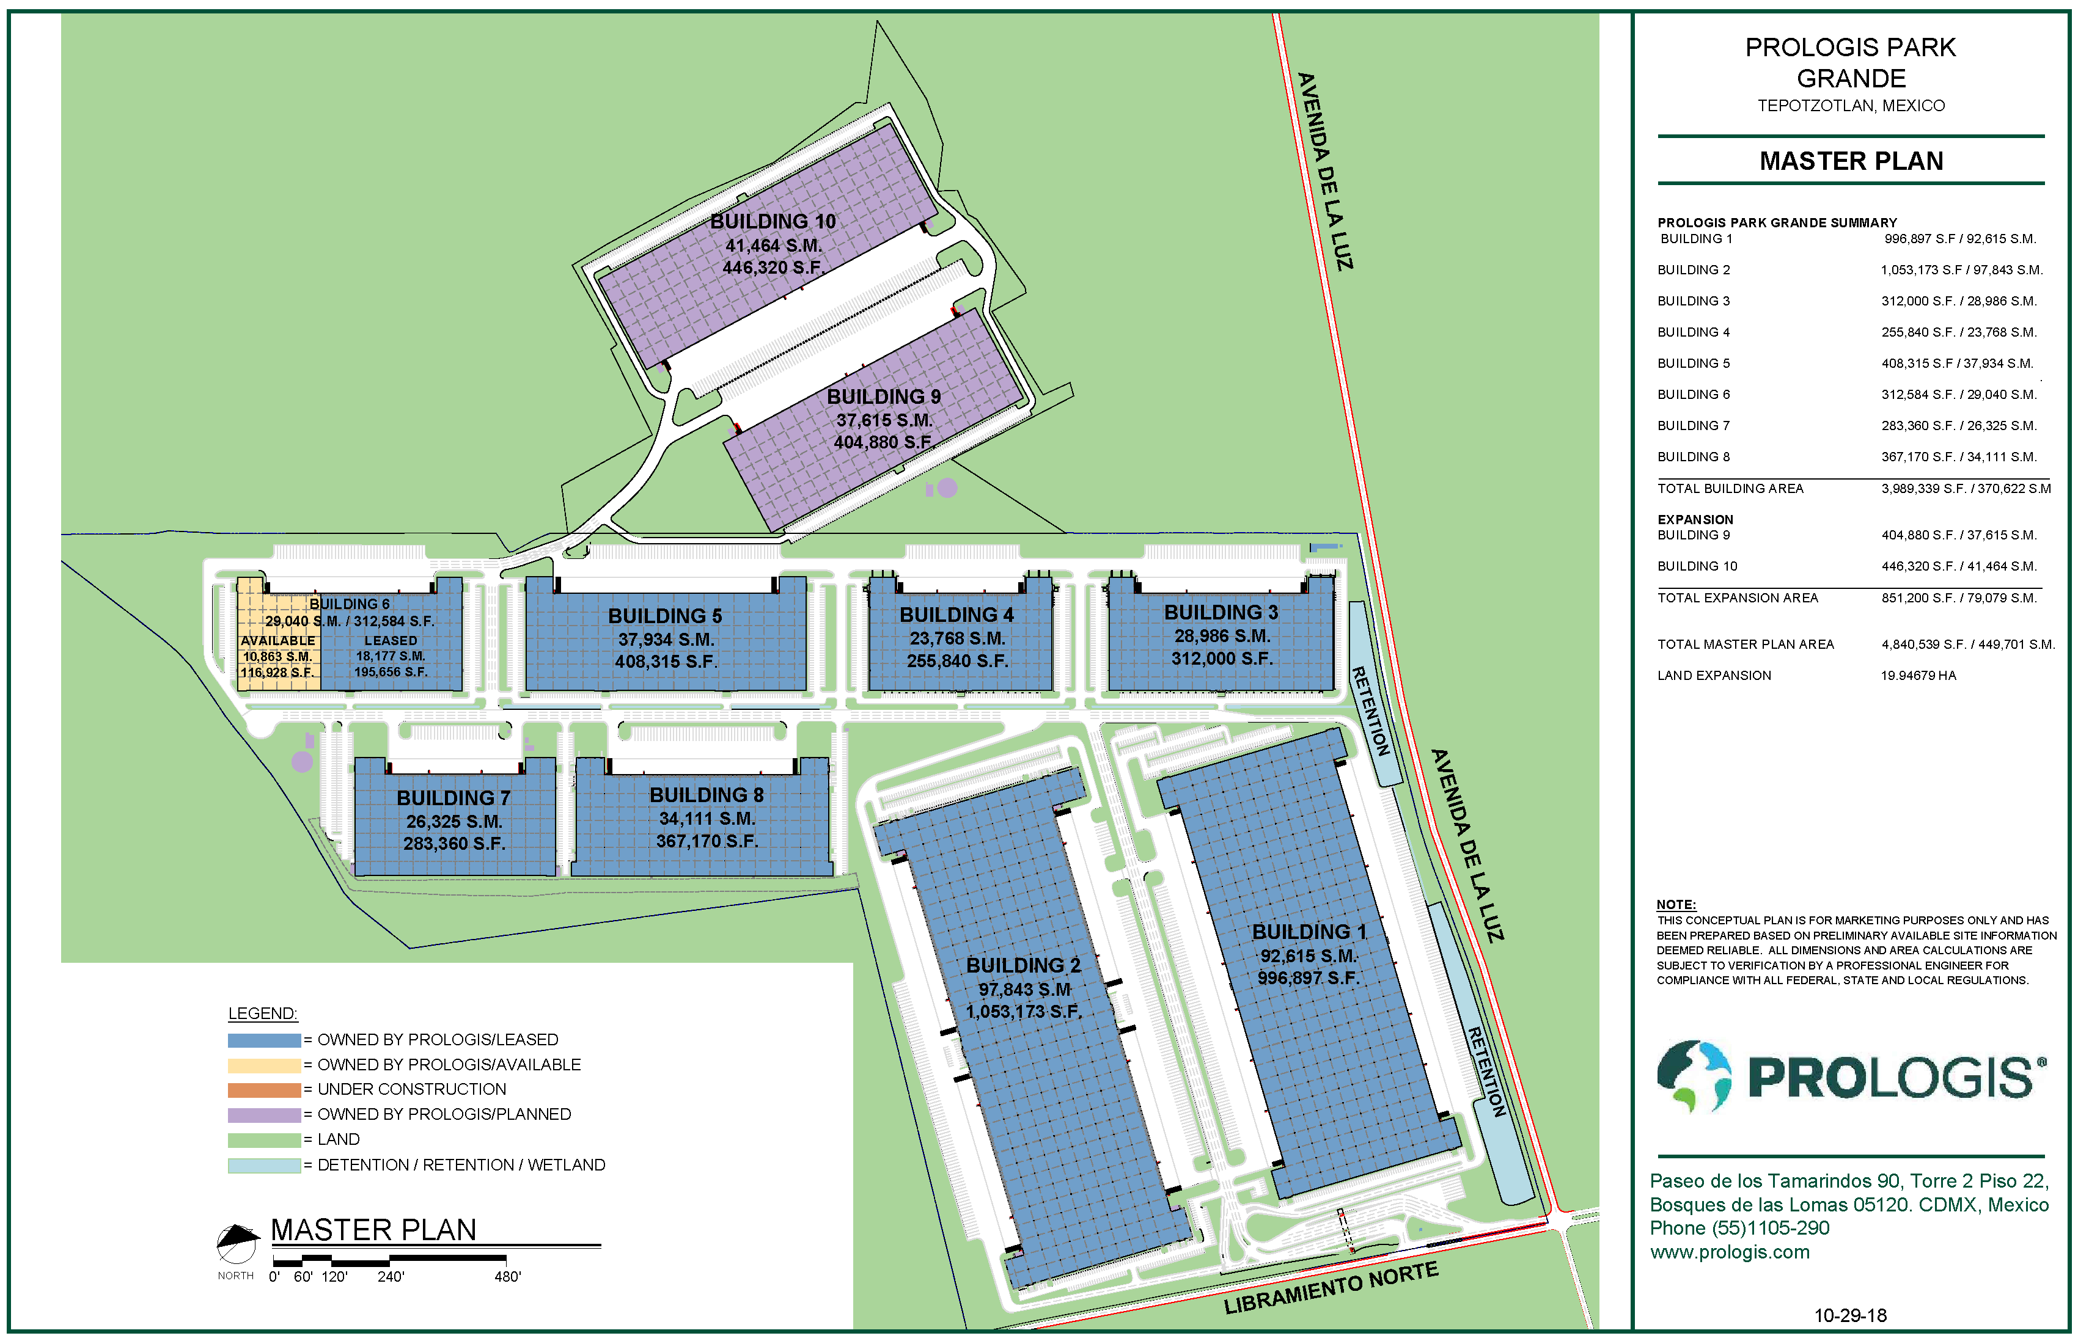
Master plan
Prologis Park Grande

Slide 20
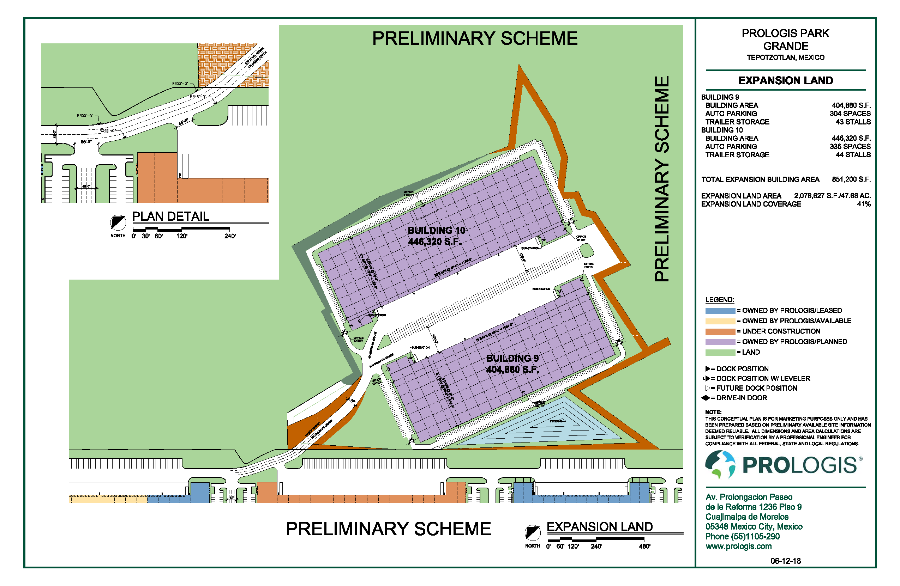
Master plan
Prologis Park Grande Expansion

Slide 21
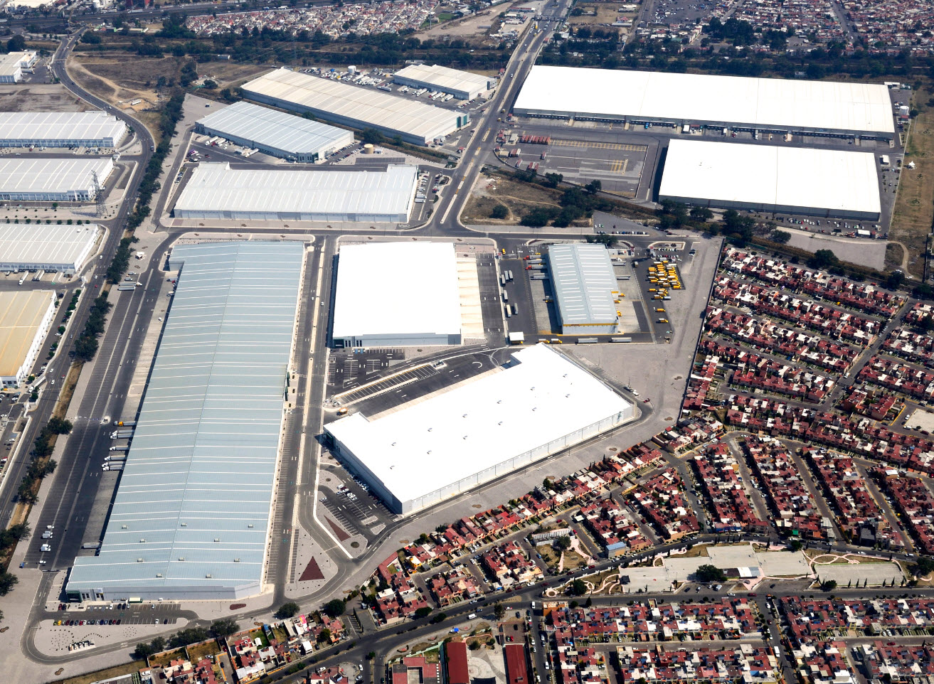
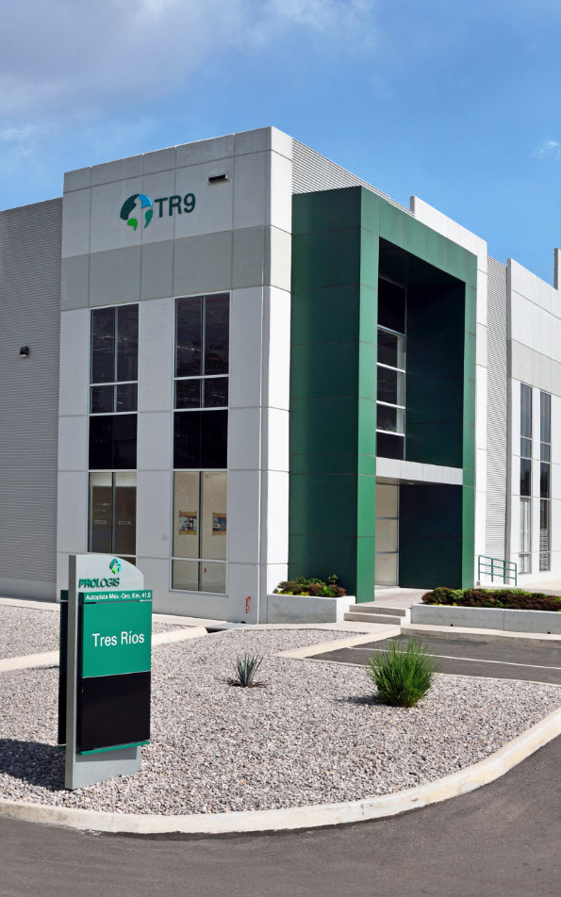
Prologis Park Tres Rios
Aerial Photography

Slide 22
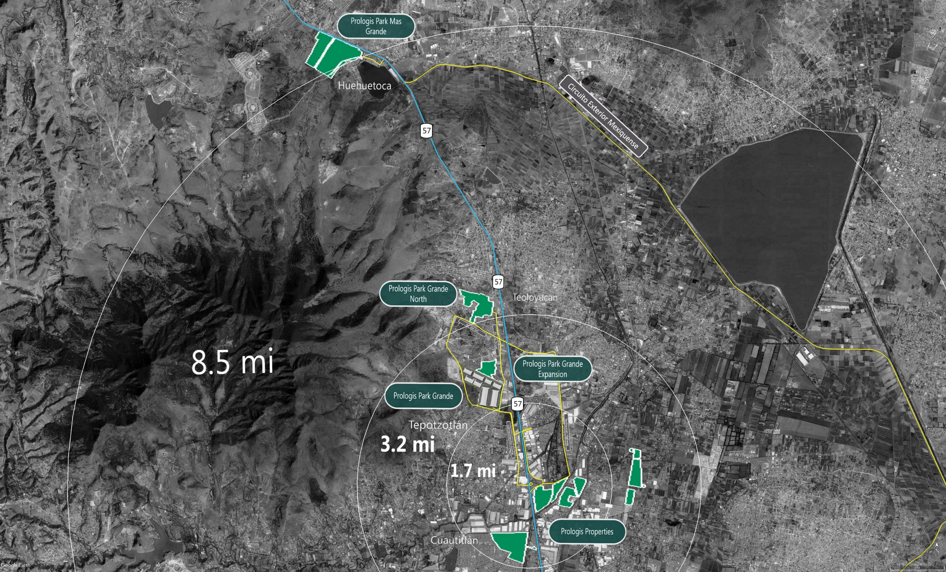
Ahead of What’s Next ! ! !
Future Land Options

Slide 23


